Slide 1
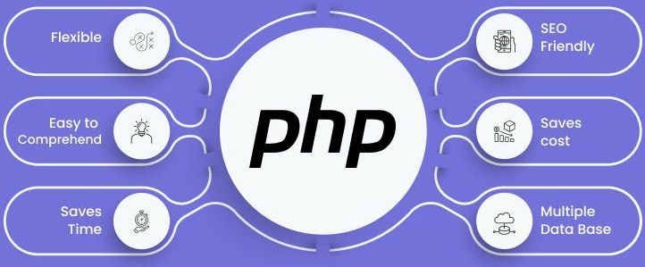

Slide 2
About today…
Loops
for loop
while loop
do-while loop
foreach loop

Slide 3
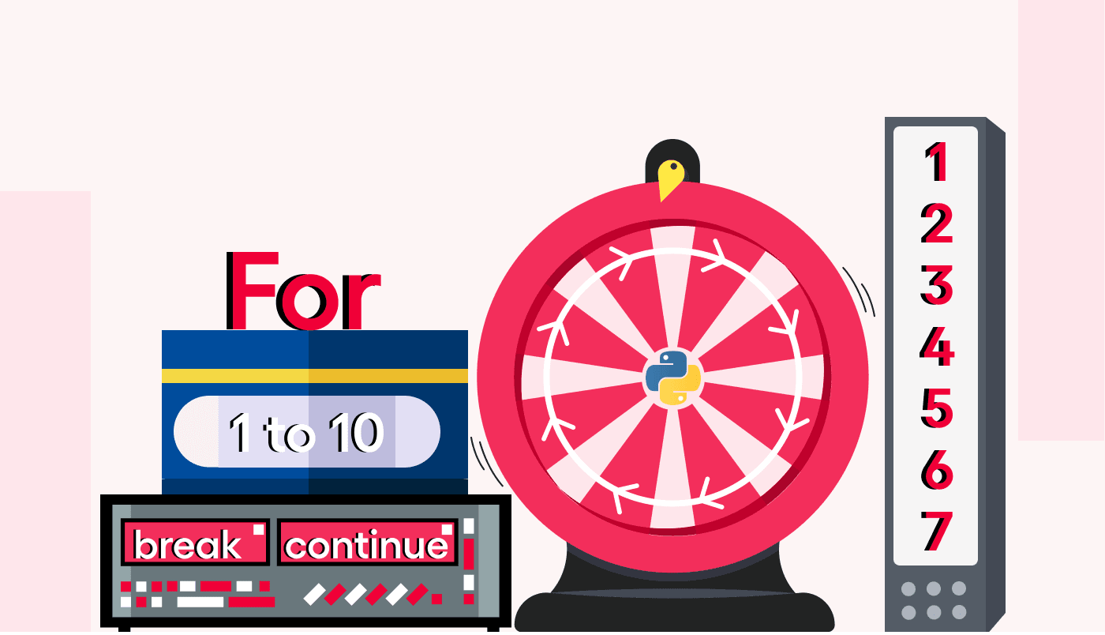

Slide 4

For Loop
Initialization
Executed once at the beginning
Condition
Evaluated before each iteration
Loop continues as long as the condition is true
Increment/Decrement
Executed at the end of each iteration

Slide 5

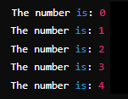
For Loop
Example
Output

Slide 6
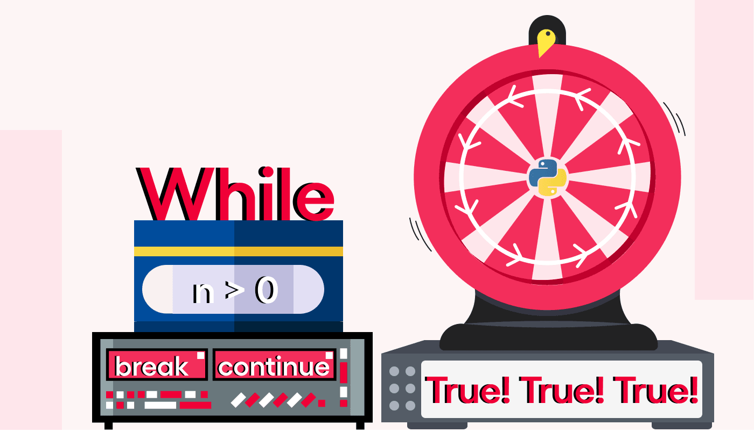

Slide 7

While Loop
Condition
Evaluated before each iteration
Loop continues as long as the condition is true

Slide 8
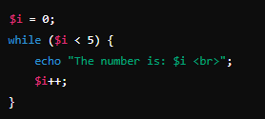
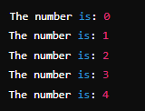
While Loop
Example
Output

Slide 9
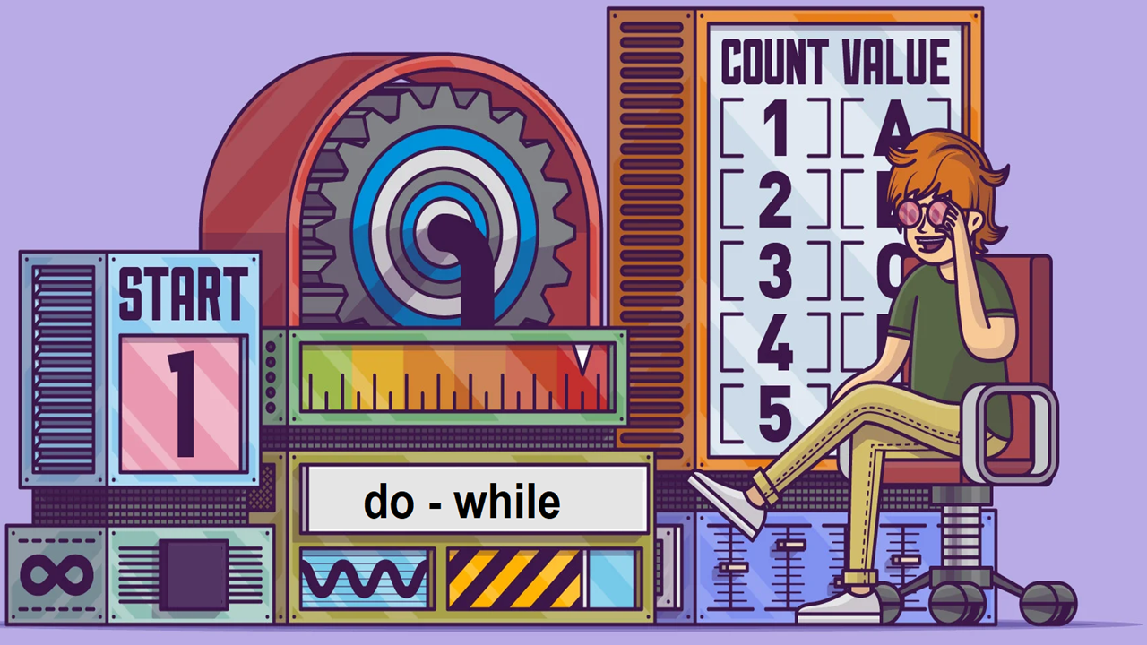

Slide 10

Do-while Loop
Code Block
Executed at least once before the condition is tested
Condition
Evaluated after each iteration
Loop continues as long as the condition is true

Slide 11
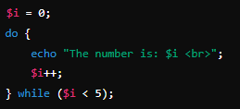
Do-while Loop
Example
Output

Slide 12


Slide 13


foreach Loop
OR
$array
The array to iterate over
$value
The current array element
$key
The current array key (optional)

Slide 14


foreach Loop
Example
Output

Slide 15
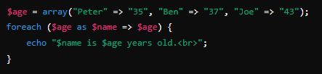

foreach Loop
Example
Output

Slide 16


Slide 17

Which loop type is suitable when the number of iterations is known beforehand?
a) for loop
b) while loop
c) do-while loop
d) foreach loop
In a for loop, where is the increment/decrement statement typically placed?
a) Before the condition
b) After the condition
c) Inside the loop body
d) None of the above
Which loop type guarantees at least one execution of the loop body?
a) for loop
b) while loop
c) do-while loop
d) foreach loop

Slide 18

Task 1
Write a for loop that prints even numbers between 1 and 10.
Task 2
Write a while loop that prints odd numbers between 1 and 10
Task 3
Write a do-while loop that counts from 10 to 1
Task 4
Use a foreach loop to iterate over an associative array of student names and their grades
Display each student's name and grade

